Slide 1
SoundScorez
Reese Champagne, Jeanne Yedo, Walter Cunningham, Mark Doronio

Slide 2
Introduction to Audio Competitions
Outside events where audio vehicles line up to get their systems metered for loudness (dB)
TermLab software accurately measures SPL to .01 dB
Variety of classes for specific types of audio cars (demo, burp, build type)
Most of the time, the TermLab meter goes on the interior passenger windshield
Bowling trophy for most small competitions, but national finals has an actual trophy

Slide 3
Current Environment
Once a vehicle has metered, the judge handwrites the name, class, and score of the competitor
After the event, the judge types all of the scores and classes in an email to the coordinator
The coordinator then types the information from the email into an Excel Spreadsheet and runs calculations to sort the results
Finally, the coordinator takes the Excel information and creates a score page similar to Fig. 1 on the BassWars website

Slide 4
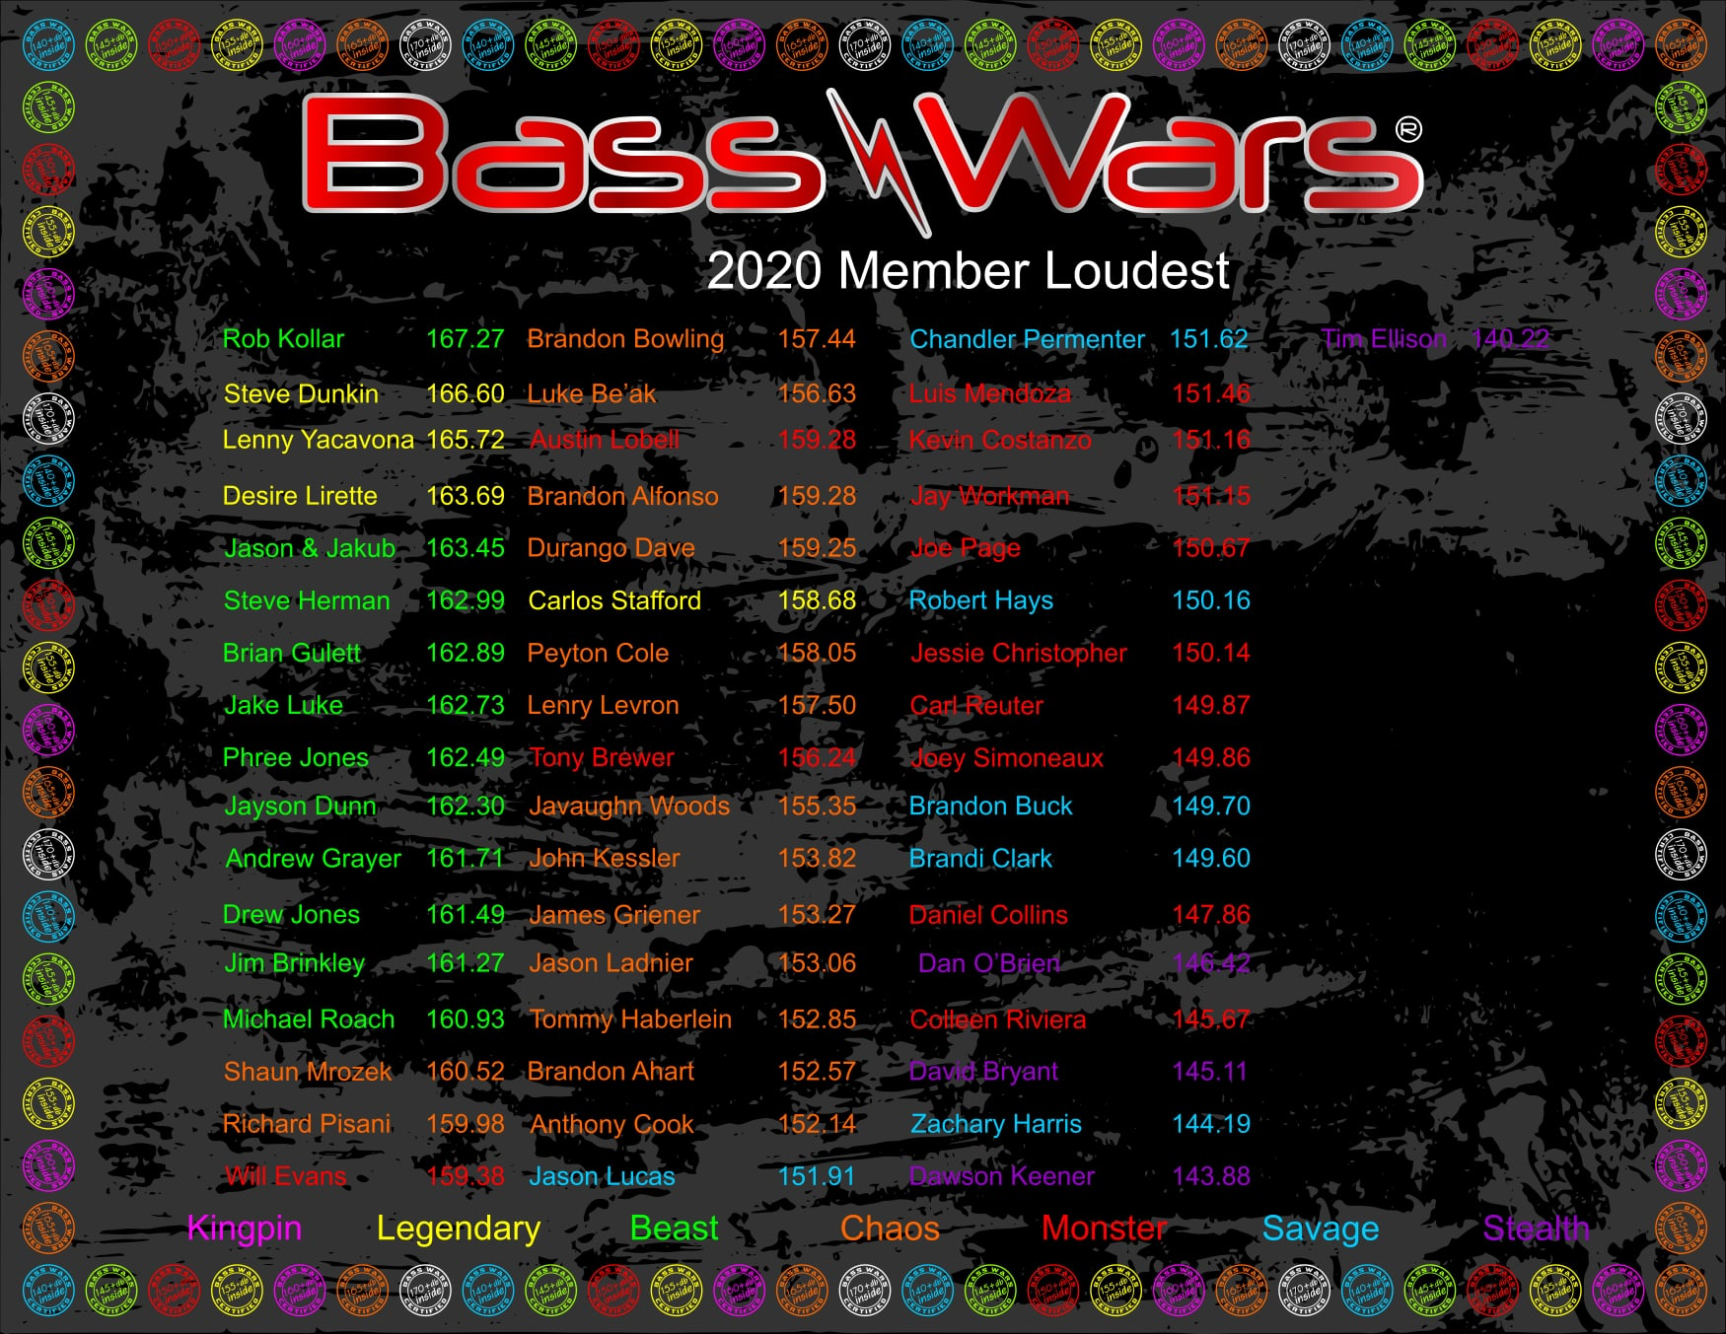
Fig. 1
Notice how hard this is to see.

Slide 5
User Stories
“As a judge, I need a sorted list of today’s competitors and their scores, so that I can announce the winners at the end of the day.”
“As a judge, when a competitor or spectator inquires about current scores, I should be able to search the name of the person and be shown a list of their scores in each class they've competed in so far.”
“As a webmaster, I need to have a single place on the website to upload the TermLAB file to, so I don’t get frustrated and stop using the program and going back to my old, manual way.”
“As a user of the website, I need to be able to find the class, score, and rank of any given competitor who has competed in this audio season for this organization, so that I can see where I (or my friend) is at on the ranking list.”

Slide 6
Mock-Ups

Slide 7
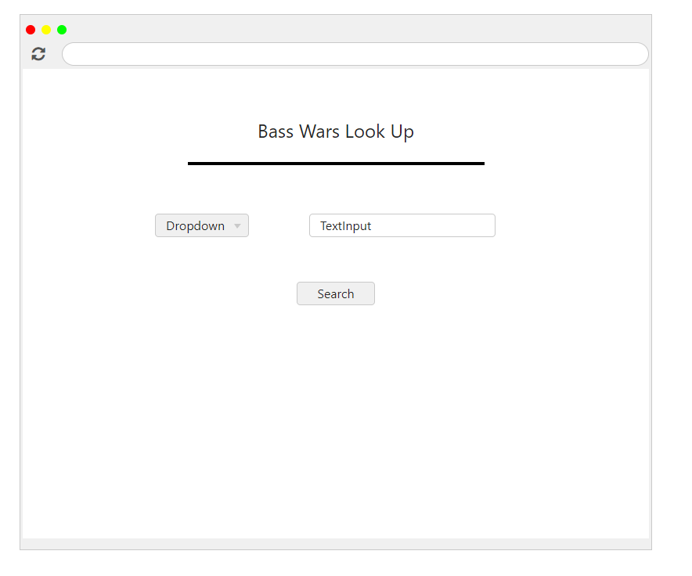
Lookup Screen
“As a user of the website, I need to be able to find the class, score, and rank of any given competitor who has competed in this audio season for this organization, so that I can see where I (or my friend) is at on the ranking list.”
Notes:
Acceptance Criteria:
Ability to toggle between current work (taking scores) and searching the database
Search bar for name, that delivers scores by class
Must be fast, and easy to read as to not detract from competition

Slide 8
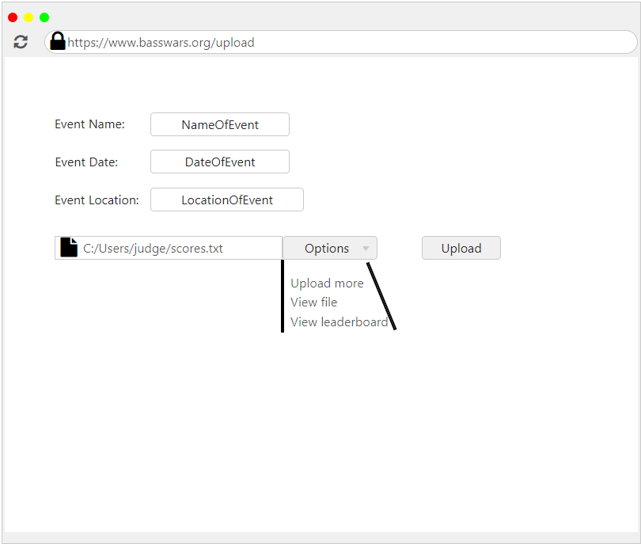
Upload Screen
“As a webmaster, I need to have a single place on the website to upload the TermLAB file to, so I don’t get frustrated and stop using the program and going back to my old, manual way.”
Notes:
The file should only be uploaded once, but used internally multiple times
User interface and give users multiple options to upload files by including a drag-and-drop box along with traditional file input
Require users to submit a set naming convention of TermLAB files that we can later parse for information such as the date of the event

Slide 9
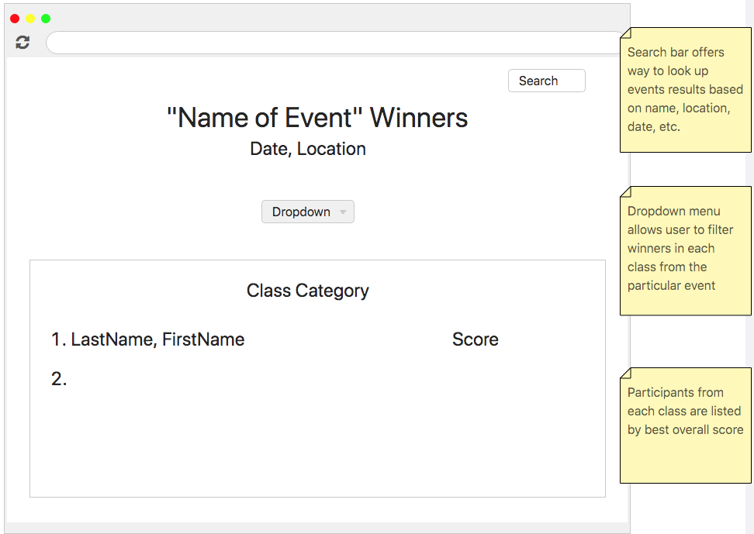
Winner’s Screen
“As a judge, I need a sorted list of today’s competitors and their scores, so that I can announce the winners at the end of the day.”
Notes:
Output accurate to 2 decimal places
Text color changes on competitors who tie (have the exact same score) with each other
Outputs the text file input as an easy to comprehend ranking list in less than 3 seconds

Slide 10
Architecture & Design
Notes:
Briefly cover the structure of our system and the interactions between components; subsystems & framework for sub-system control and communication

Slide 11
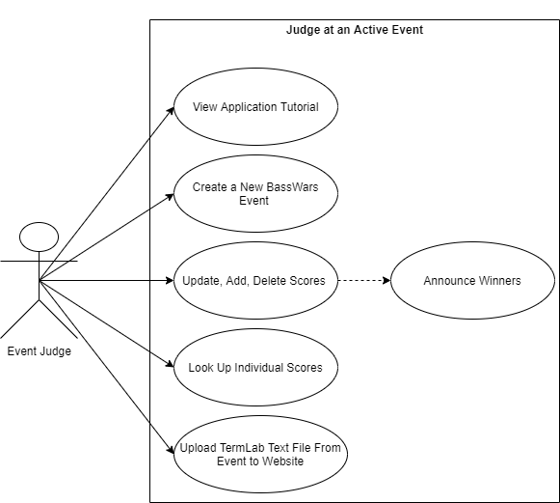
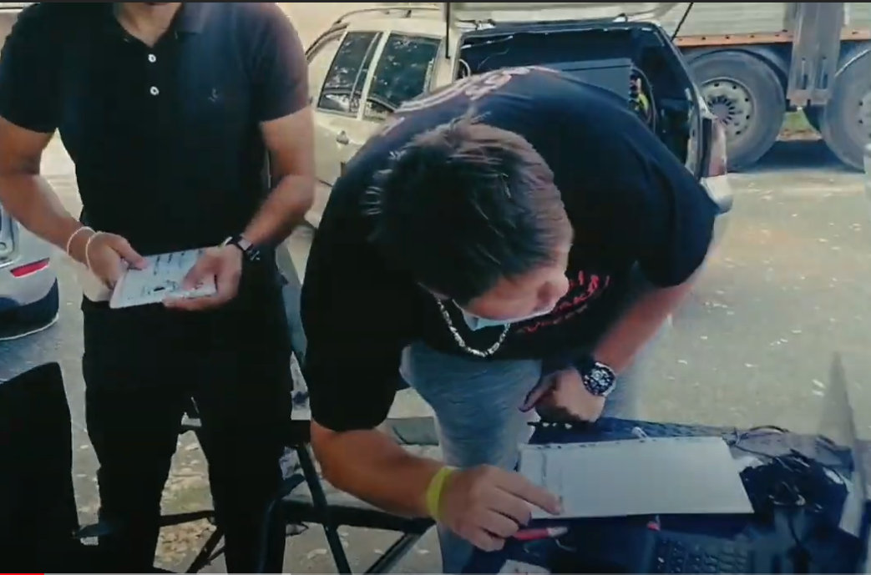
Interaction Model: Use Case
Notes:
Interactions between the system and external agents; Primary Actor = Event Judge; Everything within the box represents tasks completed within our system environment

Slide 12
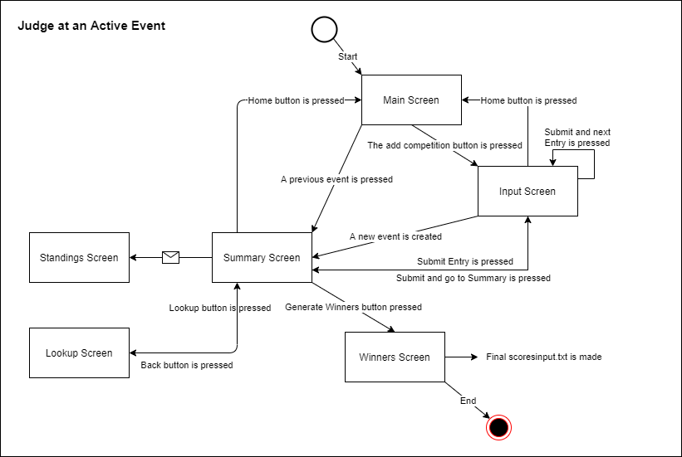
Context Model: Activity Diagram
Simple navigation through the SoundScorez web application
5 Primary Screens
Main (Home)
Input
Summary
Winner
Lookup
Standings
Notes:
Flow of control from one activity to another; rectangles represent system displays;

Slide 13
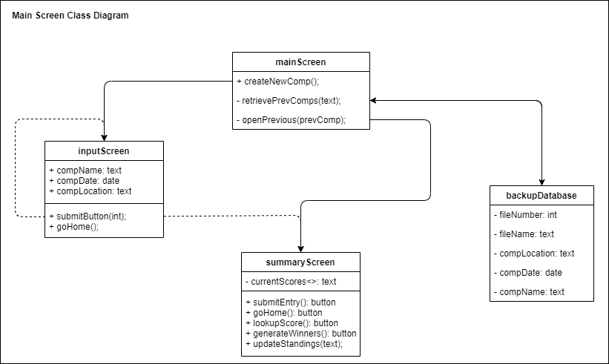
Structural Model: Class Diagram
Primary Objects
mainScreen
inputScreen
summaryScreen
backupDatabase
Attributes
Operations
Notes:
Our system contains 4 primary objects each with their associated attributes & operations

Slide 14
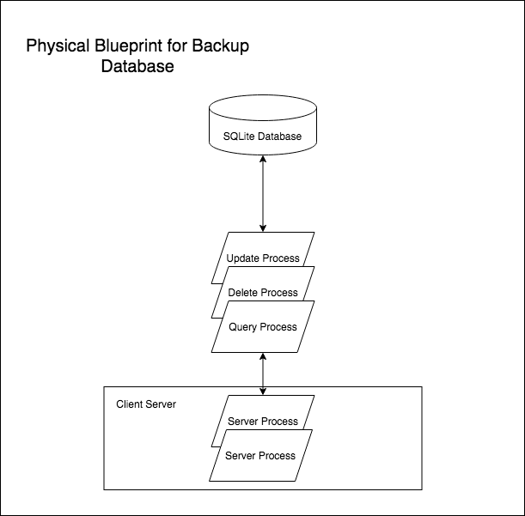
Physical View: Backup Database
SQLite Database Deployment
Local rather than hosted on a separate database server
Interaction with our client server through manipulation and modification statements

Slide 15
Quality Plan
High quality through vigorous testing of function processes and system attributes
Interface designed for 2 different groups: Facilitators and Competitors/Spectators
Facilitators will focus on creating new competition instances, sorting results, and uploading TermLab files to the website
Competitors/Spectors will focus on searching competition standings and filtering results
Change Process
High Priority - Fixed ASAP
Medium Priority - Pushed out on next release
Low Priority - Pushed out on future release as time permits
Version Release
Plan release
Build release
Test user acceptance
Prepare release
Deploy Release

Slide 16
Risks and Risk Management
Risks | Mitigation
Incoherent coding styles | Written set of rules regarding programming style and formatting
Lack of pre-developed programs - Ground of build style does not come with any proven-working programs | Each object should be made to be compatible and flexible with other parts of the program so they are able to be implemented elsewhere within the program
Lack of communication with end-client | Regular updates sent to client
Implementation trouble with TermLab | Make sure the program is able to decipher and present the information exported from the TermLab program. Communicate issues with TermLab team for guidance

Slide 17
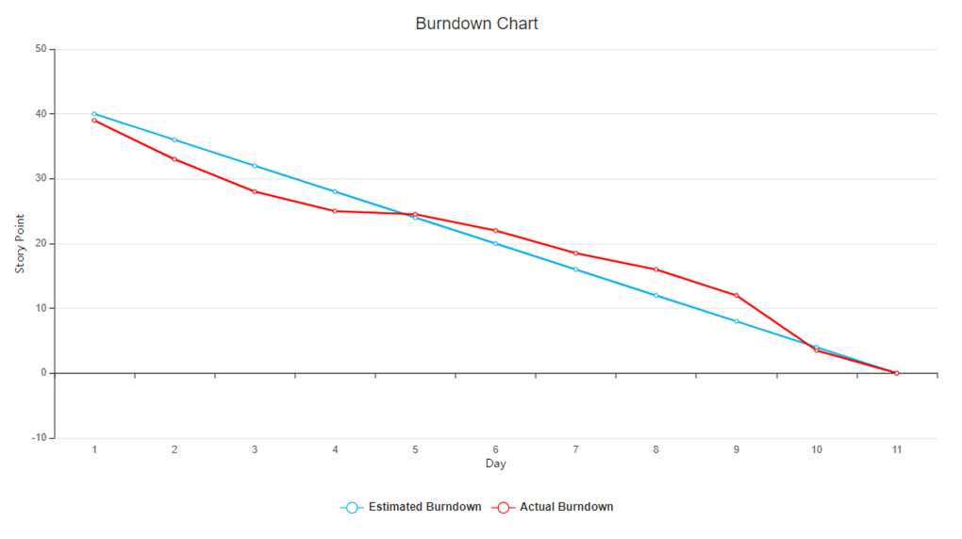

Slide 18
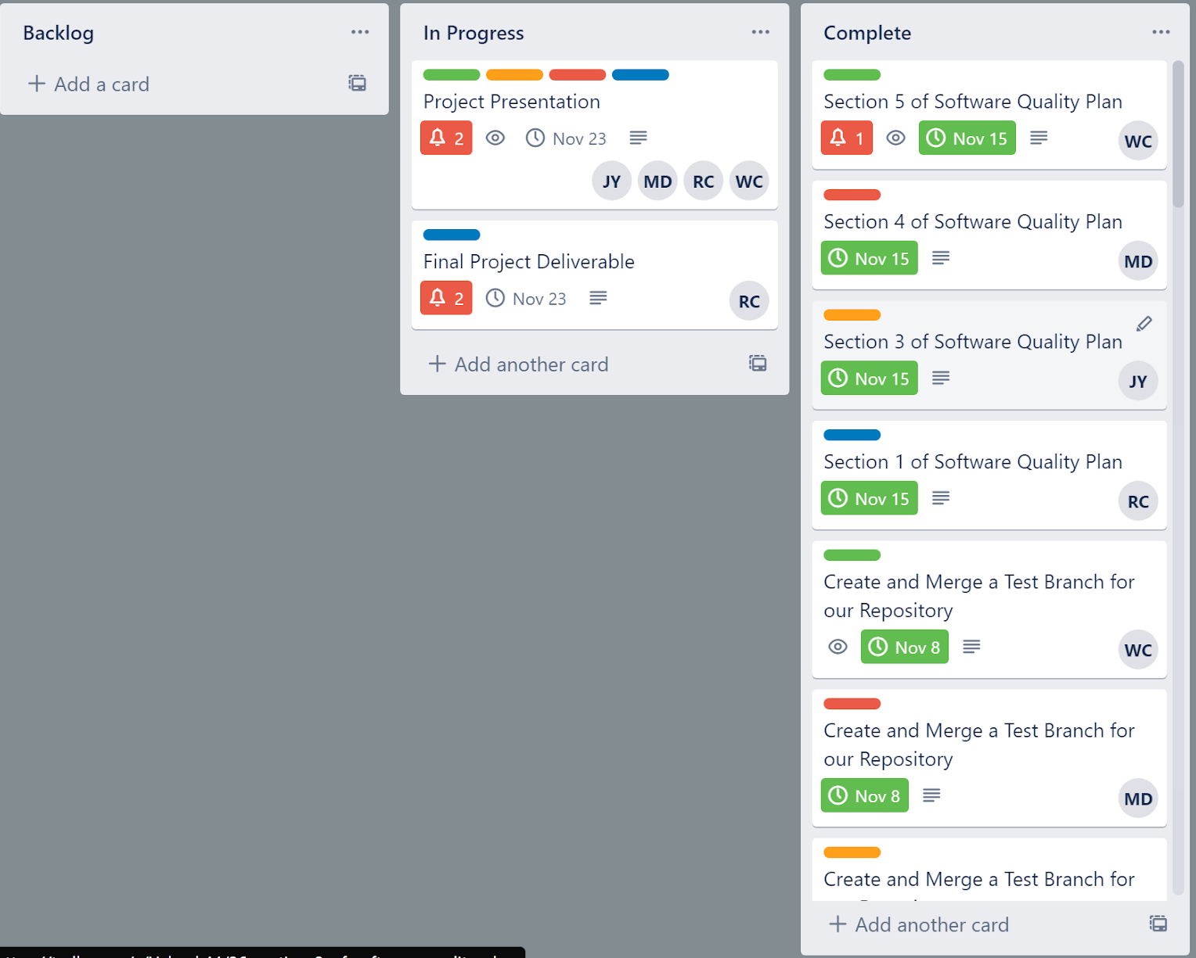
Management Approach
Trello was used to keep track of progress and work divided between the team members
Discord used to communicate
Weekly sprints with work divided between each member
Weekly meetings to go over work completed, any work that may of been backlogged, and work needed for the next sprint

Slide 19
Kanban Overall
What went well
What could of gone better
Easy to keep track of work through each sprint
Specifically divided work
Week by Week planning
More consistent weekly meetings
Planning work throughout the week instead of one or two days
Better communication between all team members (Different communication program)

Slide 20
Conclusion

